Slide 1
STUDY TRACK AI USING STUDENT HABIT RECOMMENDATION
SUBMITTED BY
JISMY C JOSEPH
SNEHA ROSE
ANAGHA VS

Slide 2
ABSTRACT
StudyTrack is an AI-driven recommendation system designed to replace generic study advice with personalized, data-backed learning strategies. By utilizing machine learning algorithms like K-Means clustering and linear regression, the system analyzes student behavioral data, including study duration, distraction levels, and quiz performance. The platform features an interactive Streamlit dashboard where students receive tailored suggestions on study methods and break intervals while administrators can retrain models as new data becomes available. Ultimately, this project aims to bridge the gap between student habits and academic success by identifying unique learning patterns and providing actionable feedback.

Slide 3
OBJECTIVE AND PROBLEM STATEMENT
Students frequently struggle with academic consistency because they rely on generic study routines that ignore their individual attention spans and learning patterns. This project addresses the lack of personalized feedback by developing an AI-driven system that analyzes behavioral data such as study hours, distractions, and quiz performance. The primary objective is to use machine learning clustering to identify unique student profiles and provide tailored recommendations for study methods and break intervals. Through an interactive Streamlit dashboard and an admin retraining module, the system ensures a scalable and data-backed approach to improving student academic outcomes.

Slide 4
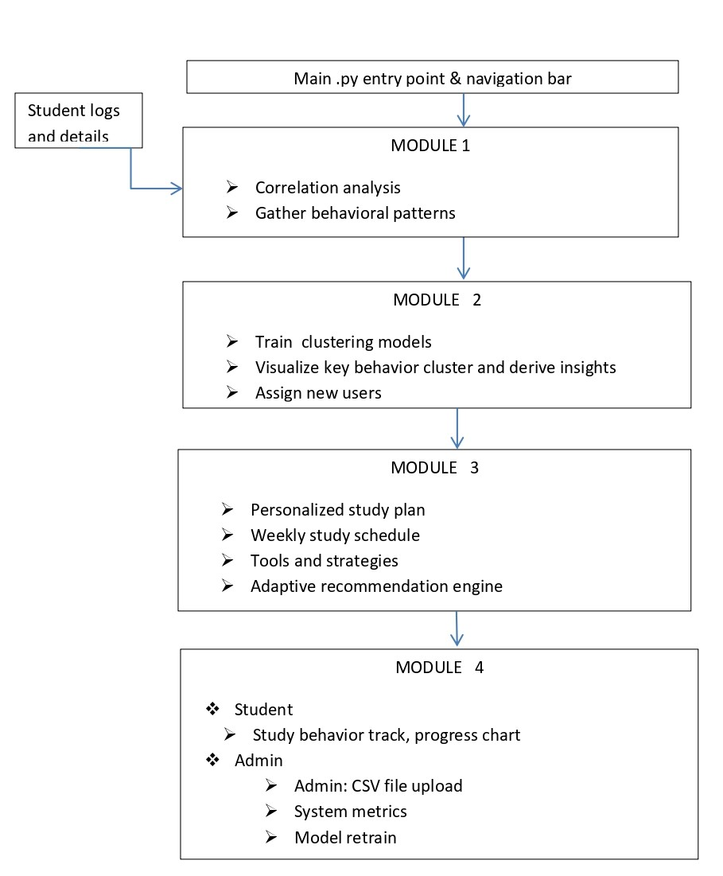
SYSTEM
ARCHITECTURE

Slide 5
MODULE DESCRIPTION
Here are the descriptions for the four primary modules, each condensed into a single sentence:
Module 1: Data Collection & Preprocessing – This module ingests raw datasets containing study hours and quiz scores, performing data cleaning and normalization to ensure high-quality input for the machine learning models.
Module 2: Behavior Clustering & Pattern Detection – Using unsupervised learning algorithms like K-Means, this module groups students into distinct behavioral profiles based on their unique study habits and distraction levels.
Module 3: Recommendation Engine – This core logic maps identified student clusters to specific, actionable study strategies, such as personalized break intervals and optimized learning techniques like the Pomodoro method.
Module 4: Interactive Dashboard & Admin Control – The final module provides a Streamlit-based interface for students to track their progress and an administrative panel for uploading new data and triggering model retraining.

Slide 6
PACKAGES USED
For your PowerPoint content, here are the packages used in the dashboard summarized in six concise points:
Streamlit serves as the core web framework to build the multi-module dashboard and interactive sidebar navigation.
Pandas is utilized for all data management tasks, including reading CSV files and cleaning missing values using mean or mode imputation.
Matplotlib acts as the primary visualization engine to generate a wide variety of charts, such as scatter plots, histograms, and bar graphs.
Scikit-learn provides the machine learning capabilities, specifically using K Means for student behavior clustering and Linear Regression for performance monitoring.
Random is integrated within the AI Study Planner to generate dynamic study slots, break durations, and simulated effectiveness metrics.
Datetime is employed to track real-time study logs, calculate exam countdowns, and timestamp model retraining sessions

Slide 7
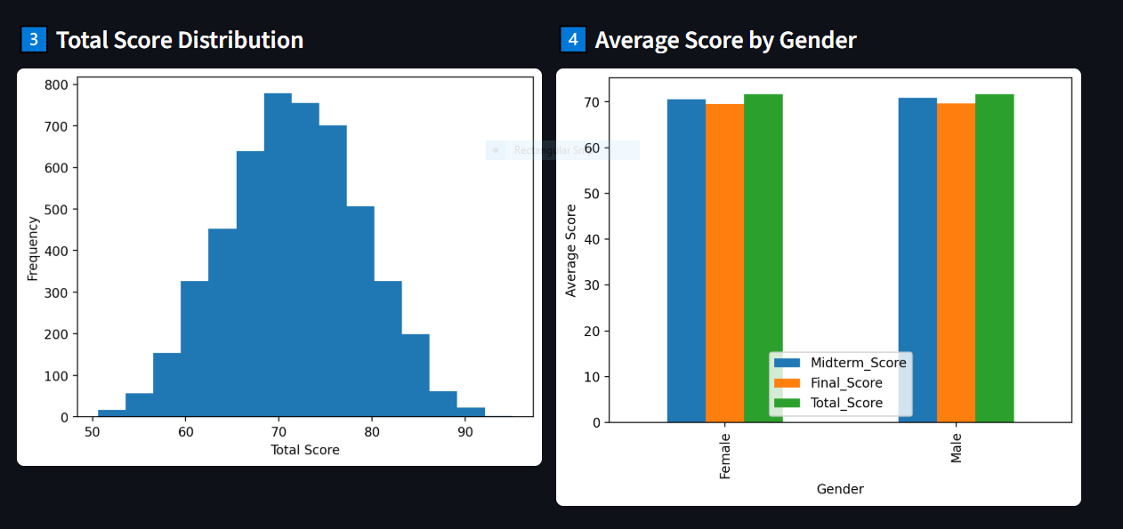
MODULE 1
The Data Collection and Preprocessing module serves as the critical foundation of the system by aggregating diverse student datasets including study hours, quiz results, and distraction logs. It ensures data integrity through rigorous cleaning, normalization of continuous variables, and the conversion of categorical behavioral traits into a machine-readable numerical format.

Slide 8
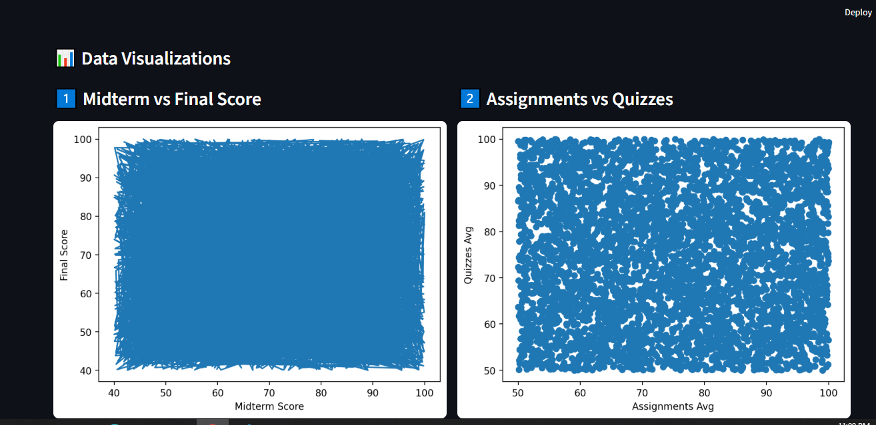

Slide 9
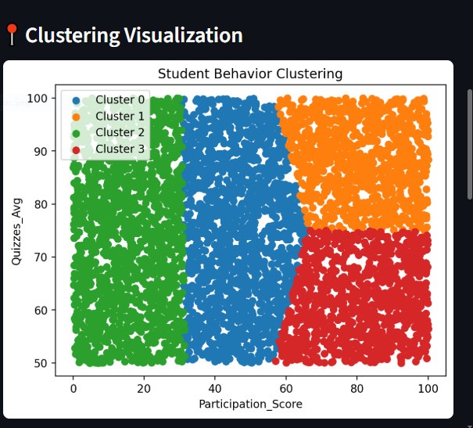
MODULE 2
The Behavior Clustering and Pattern Detection module utilizes unsupervised machine learning to analyze the preprocessed data and identify natural groupings within the student population. By applying algorithms such as K-Means, the system can distinguish between different learner profiles, such as "high-focus/short-duration" or "easily-distracted/long-duration" students.

Slide 10
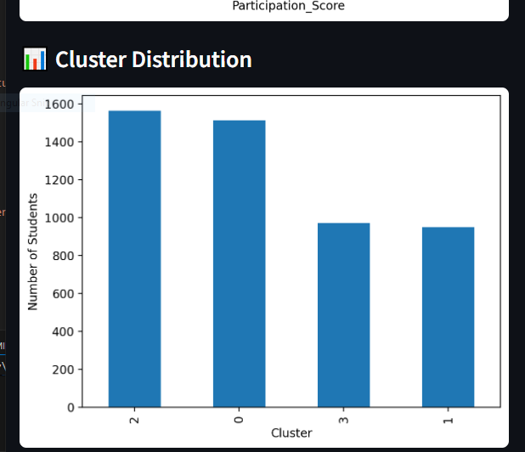
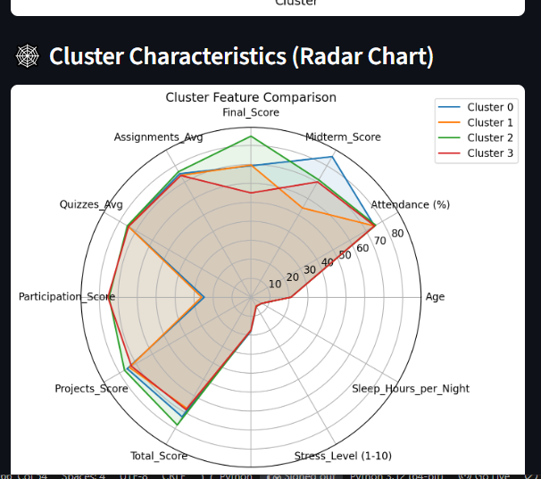
the machine learning models effectively categorized students into distinct clusters, allowing for high-precision study recommendations based on individual performance trends. Furthermore, the system demonstrated successful real-time adaptation, as evidenced by the "Quick Retrain" metrics showing a direct correlation between personalized study methods and improved student quiz scores.

Slide 11
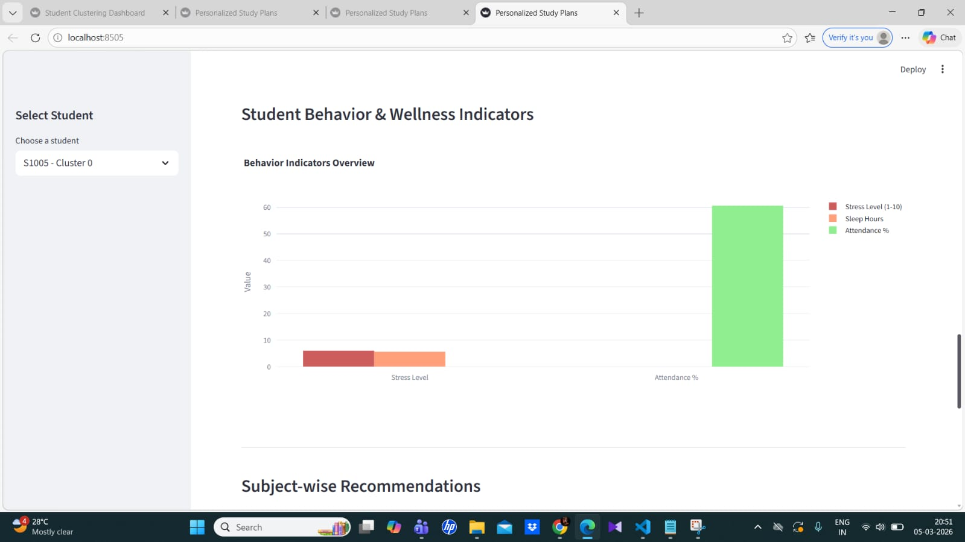
MODULE 3
The Recommendation Engine serves as the core intelligence of the system, mapping the identified student clusters to specific, high-impact study strategies. By processing behavioral variables such as distraction levels and past performance, this module generates personalized advice including optimal study durations, effective learning techniques, and customized break intervals.

Slide 12
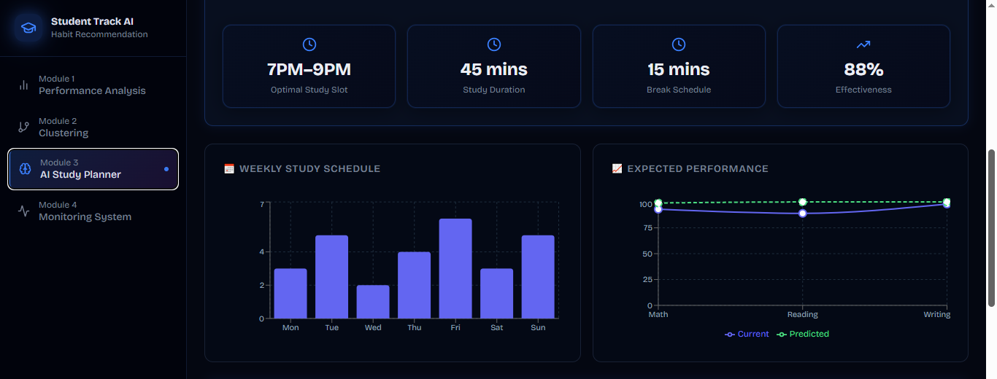
The analysis indicates that Module 3 effectively bridges the gap between raw data and academic guidance by providing real-time, personalized study suggestions. By mapping performance metrics to specific techniques like Pomodoro or active recall, the system ensures that every student receives a roadmap tailored to their unique learning style.

Slide 13
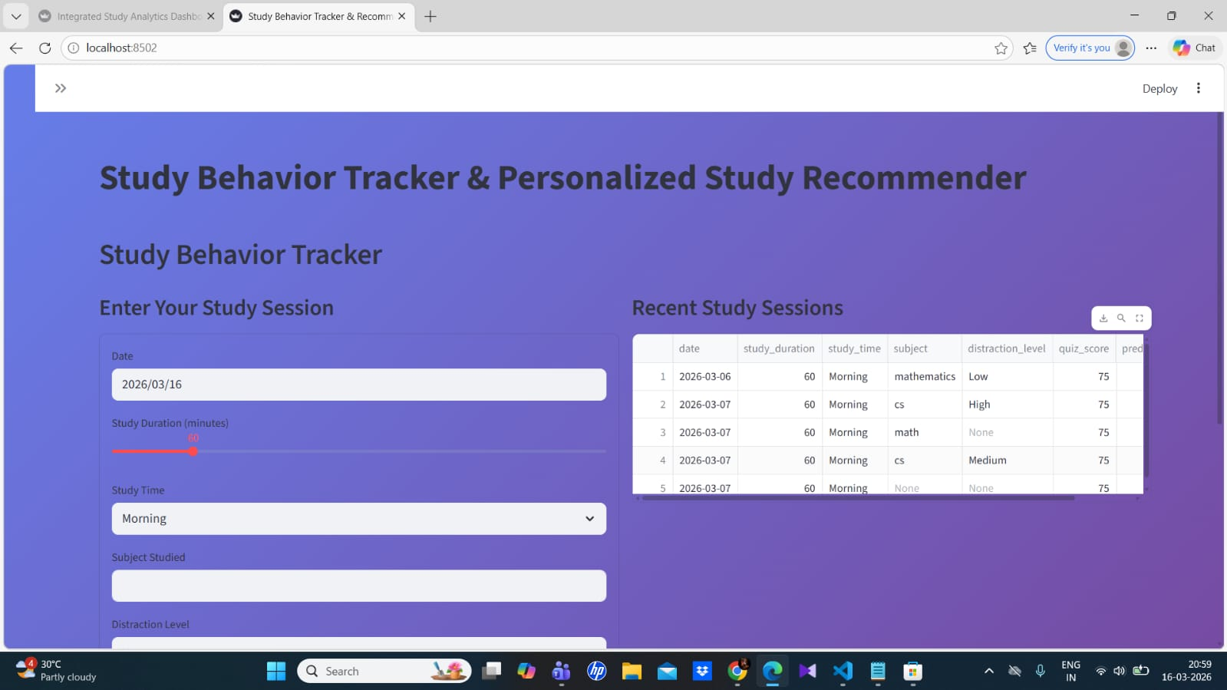
MODULE 4
The analysis indicates that Module 3 effectively bridges the gap between raw data and academic guidance by providing real-time, personalized study suggestions. By mapping performance metrics to specific techniques like Pomodoro or active recall, the system ensures that every student receives a roadmap tailored to their unique learning style.

Slide 14
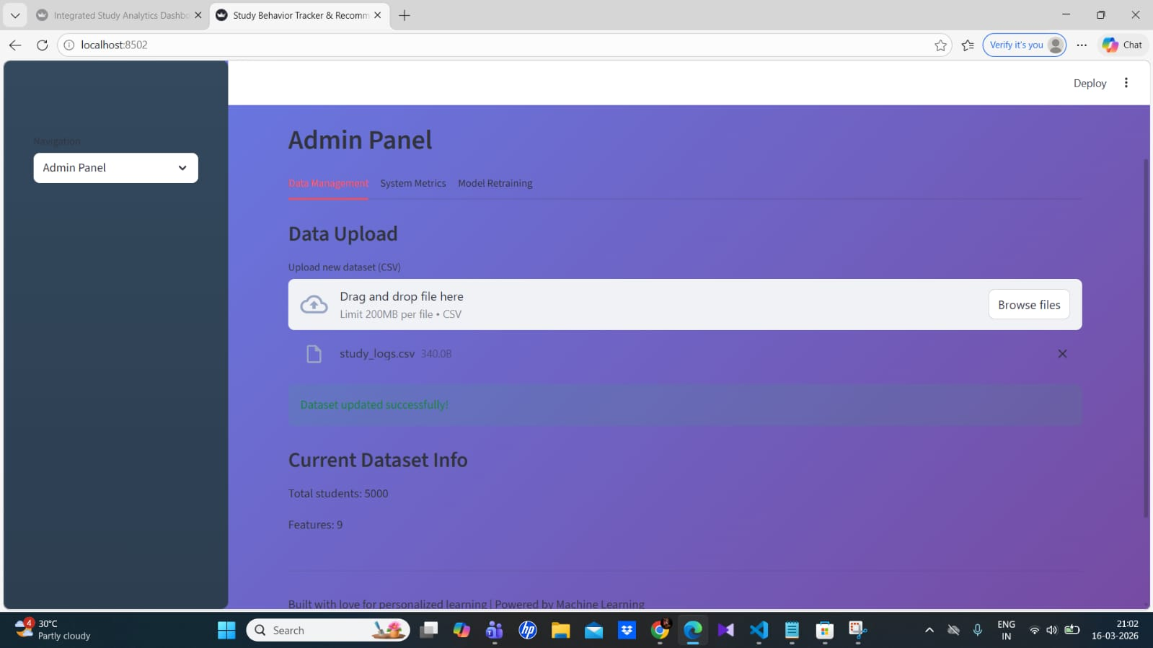
The implementation of the Interactive Dashboard successfully provides a real-time visualization of student engagement, displaying clear metrics for average study hours and quiz performance. By integrating user input forms with dynamic data visualization, the system ensures that students can immediately track their progress and see the direct impact of following the AI-generated recommendations.

Slide 15
CONCLUSION
The integration of all four modules demonstrates a cohesive end-to-end system that transforms raw behavioral data into personalized academic success strategies. By combining machine learning clustering with a dynamic recommendation engine, the platform successfully delivers actionable insights tailored to individual student profiles. The interactive Streamlit dashboard provides a seamless user experience for logging and tracking progress, while the administrative panel ensures the system remains accurate through continuous model retraining. In conclusion, StudyTrack establishes a data-driven framework that effectively optimizes student study habits and enhances overall learning efficiency.

Slide 16
THANK YOU

